Slide 1
Integrate data from notebooks with Azure Data Factory or Azure Synapse Pipelines
Sashank Pappu
Azure Data & AI Specialist

Slide 2

Sashank Pappu
Azure Data & AI Specialist.
Certified from MIT on ‘Advanced Analytics and Big Data Challenges’. Technology Enthusiast and Data Specialist. Certified Designer in Computer Vision
• Microsoft Certified Azure Data Architect. • Microsoft Certified Azure Machine Learning Developer • Certified on Practical Data Analytics with Microsoft Cortana Intelligence Suite.
9+ years of total experience as Data Specialist and Data Engineer.
Certifications
Experience
Currently working as Independent Consultant on Azure Data & AI and Enterprise Trainer on Azure Data Analytics , Cortana Intelligence Suite and Cognitive Sciences
Expert facilitator and corporate behavioral trainer with 5 years of experience in designing programs, content development , Data Analytics and Machine Learning.
Role
Training
Sri Nag Sashank
Co-Founder & CTO of antz.ai , a niche Data & IoT company.

Slide 3




The session will span for 5 days & it is mandatory to attend all the days.
Self-Paced labs have been developed & access will be shared during the session.
The audience can participate in the leaning. However, it DOES NOT come with “Azure Subscriptions” & request users to arrange on their own.
A proctor will be available to take your queries via “Chat” window. Kindly “MUTE” and do not disturb the presenter.
The sessions are recorded. Will be made available through LMS at the end of series.
Note: More trainings on the same & similar topics would be delivered in near future. Keep your options open.
Guidelines for the event

Slide 4

Description
This module teaches how to create linked services, orchestrate data movement and transformation in Azure Synapse Pipelines and also to create Synapse Spark notebooks.

Slide 5
Agenda
Introduction to Data Integration [15 minutes]
Introduction to Linked services and datasets [10 minutes]
Demo [20 minutes]
Introduction to data flows and pipelines [10 minutes]
Demo [20 minutes]
Introduction to Synapse Spark notebook [15 minutes]
Demo [45 minutes]
Overview [15 minutes]

Slide 6

Azure Synapse
Data Integration

Slide 7












Azure Synapse Analytics
Integrated data platform for BI, AI and continuous intelligence
Artificial Intelligence / Machine Learning / Internet of Things Intelligent Apps / Business Intelligence
Experience
Azure Synapse Studio
Platform
Languages
MANAGEMENT
MANAGEMENT
SQL | Python | .NET | Java | Scala | R
Form Factors
SECURITY
SECURITY
PROVISIONED
ON- DEMAND
Analytics Runtimes
MONITORING
MONITORING
METASTORE
METASTORE
DATA INTEGRATION
Azure
Data Lake Storage
Common Data Model Enterprise Security Optimized for Analytics

Slide 8



Orchestration @ Scale
Trigger
Pipeline
Activity
Activity
Activity
Activity
Activity
Self-hosted
Integration Runtime
Azure
Integration Runtime
Linked Service
L E G E N D
Command and Control Data

Slide 9







Data Movement
Scalable
per job elasticity
Up to 4 GB/s
Simple
Visually author or via code (Python, .Net, etc.)
Serverless, no infrastructure to manage
Access all your data
90+ connectors provided and growing (cloud, on premises, SaaS) Data Movement as a Service: 25 points of presence worldwide Self-hostable Integration Runtime for hybrid movement

Slide 10
Introduction to Linked Services and Datasets

Slide 11
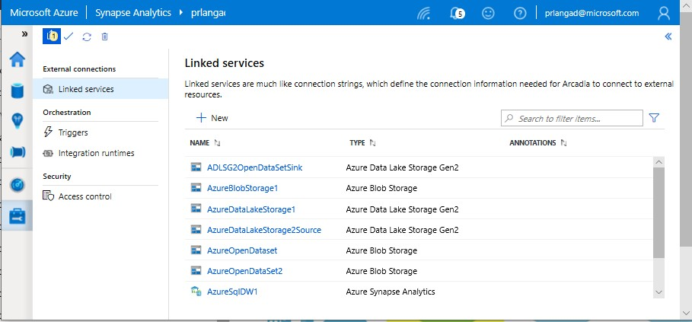
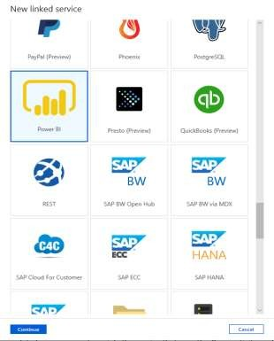
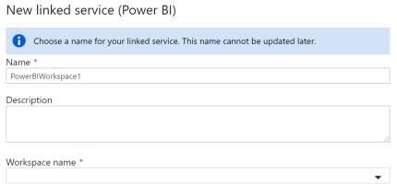
Linked Services
Overview
It defines the connection information needed for
Pipeline to connect to external resources.
Benefits
Offers pre-build 85+ connectors Easy cross platform data migration
Represents data store or compute resources
NOTE: Linked Services are all for Data Integration except for Power BI (eventually ADC, Databricks)

Slide 12
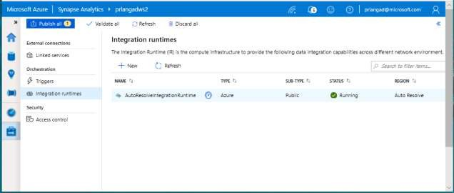
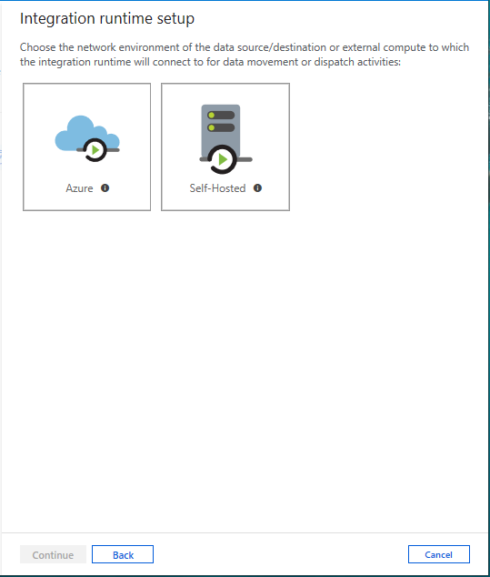
Integration runtimes
Overview
It is the compute infrastructure used by Pipelines to provide the data integration capabilities across different network environments. An integration runtime provides the bridge between the activity and linked Services.
Benefits
Offers Azure Integration Runtime or Self-Hosted Integration Runtime
Azure Integration Runtime – provides fully managed, serverless compute in Azure
Self-Hosted Integration Runtime – use compute resources in on-premises machine or a VM inside private network

Slide 13
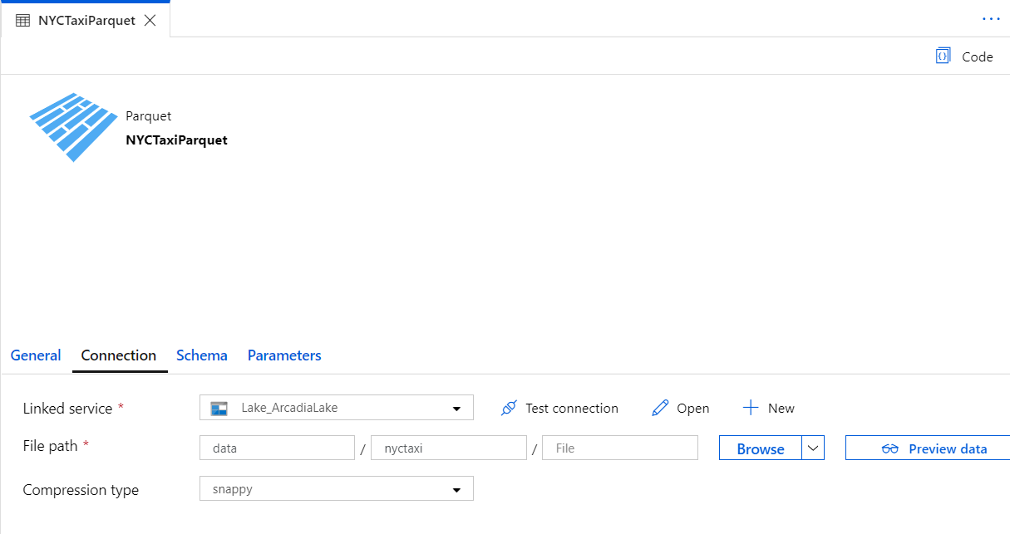
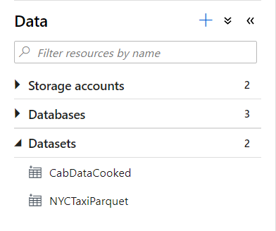
Datasets
Orchestration datasets describe data that is persisted.
Once a dataset is defined, it can be used in pipelines and sources of data or as sinks of data.

Slide 14
90+ Connectors out of the box
Azure (15) | Database & DW (26) |  | File Storage (6) | File Formats(6) | NoSQL (3) | Services and App (28) |  | Generic (4)
Blob storage | Amazon Redshift | Oracle | Amazon S3 | AVRO | Cassandra | Amazon MWS | Oracle Service Cloud | Generic HTTP
Cosmos DB - SQL API | DB2 | Phoenix | File system | Binary | Couchbase | CDS for Apps | PayPal | Generic OData
Cosmos DB - MongoDB API | Drill | PostgreSQL | FTP | Delimited Text | MongoDB | Concur | QuickBooks | Generic ODBC
Data Explorer | Google BigQuery | Presto | Google Cloud Storage | JSON |  | Dynamics 365 | Salesforce | Generic REST
Data Lake Storage Gen1 | Greenplum | SAP BW Open Hub | HDFS | ORC |  | Dynamics AX | SF Service Cloud
Data Lake Storage Gen2 | HBase | SAP BW via MDX | SFTP | Parquet |  | Dynamics CRM | SF Marketing Cloud
Database for MariaDB | Hive | SAP HANA |  |  |  | Google AdWords | SAP C4C
Database for MySQL | Apache Impala | SAP table |  |  |  | HubSpot | SAP ECC
Database for PostgreSQL | Informix | Spark |  |  |  | Jira | ServiceNow
File Storage | MariaDB | SQL Server |  |  |  | Magento | Shopify
SQL Database | Microsoft Access | Sybase |  |  |  | Marketo | Square
SQL Database MI | MySQL | Teradata |  |  |  | Office 365 | Web table
SQL Data Warehouse | Netezza | Vertica |  |  |  | Oracle Eloqua | Xero
Search index |  |  |  |  |  | Oracle Responsys | Zoho
Table storage

Slide 15
Exercise-1 [20 minutes]
Linked service and datasets
Task 1: Create linked service
Task 2: Create datasets

Slide 16
Introduction to Data flows and Pipelines

Slide 17
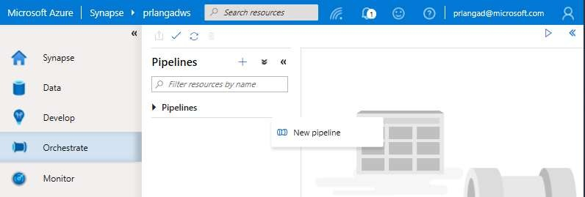
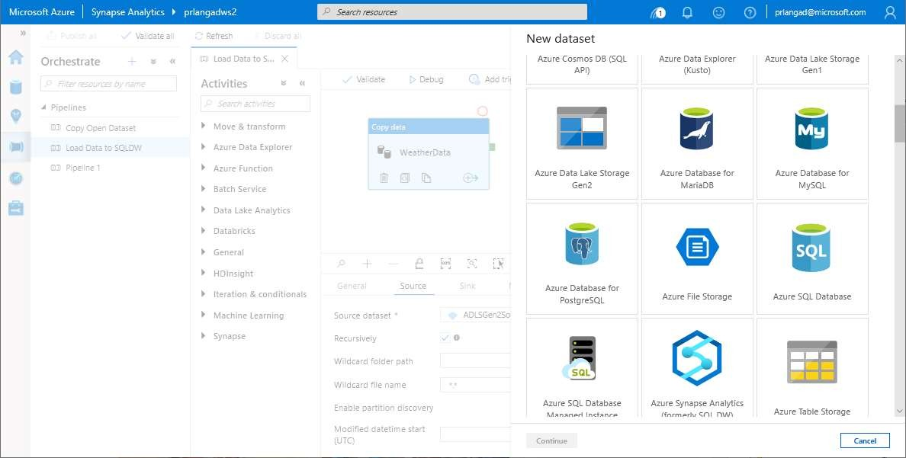
Pipelines
Overview
It provides ability to load data from storage account to desired linked service. Load data by manual execution of pipeline or by orchestration
Benefits
Supports common loading patterns
Fully parallel loading into data lake or SQL tables
Graphical development experience

Slide 18
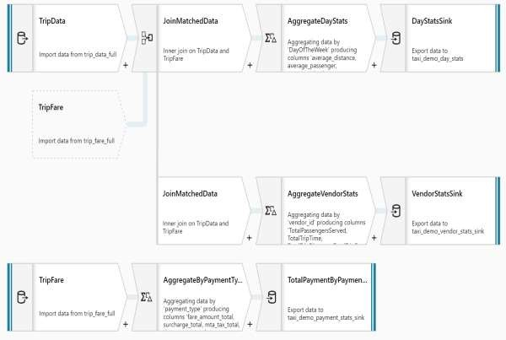
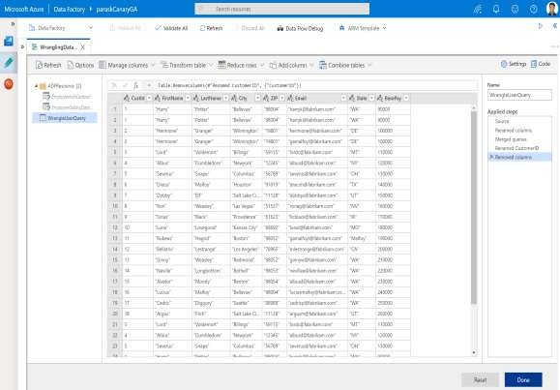
Prep & Transform Data
Mapping Dataflow
Code free data transformation @scale
Wrangling Dataflow
Code free data preparation @scale

Slide 19

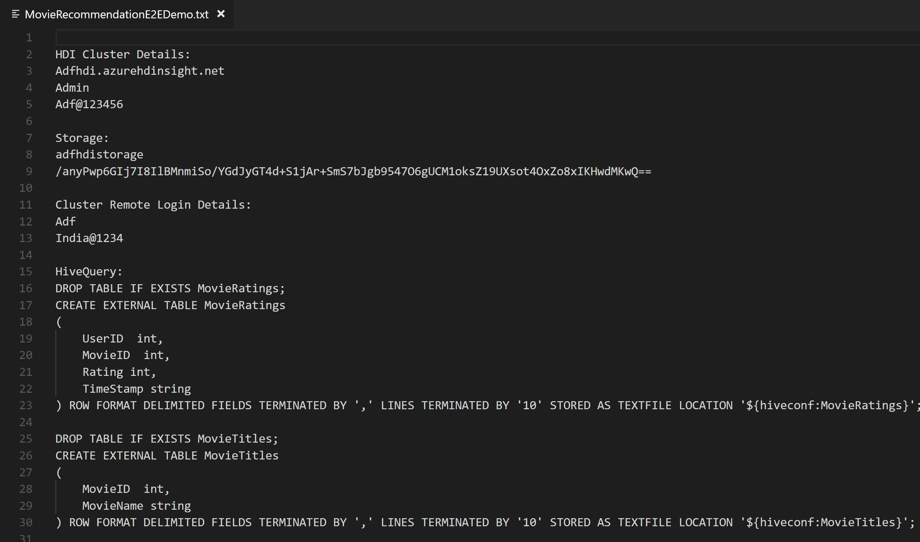
No Code Transform with Mapping Data Flows
Overview
It offers data cleansing, transformation, aggregation, conversion, etc.
Benefits
Cloud scale via Spark execution
Guided experience to easily build resilient data flows
Flexibility to transform data per user’s comfort
Monitor and manage dataflows from a single pane of glass
This…
NOT this…

Slide 20
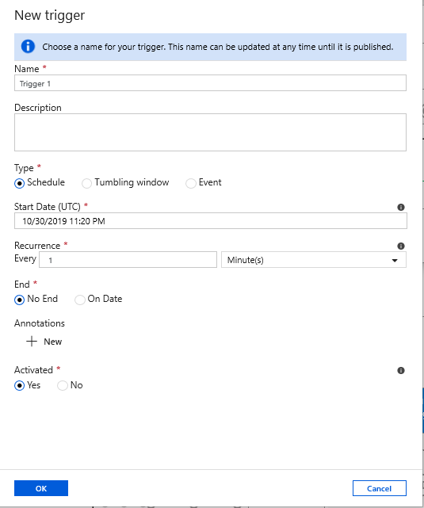
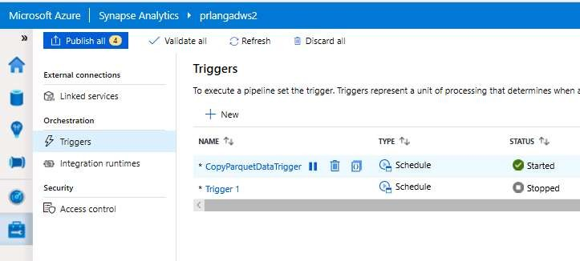
Triggers
Overview
Triggers represent a unit of processing that determines when a pipeline execution needs to be kicked off.
Data Integration offers 3 trigger types as –
Schedule – gets fired at a schedule with
information of start date, recurrence, end date
Event – gets fired on specified event
Tumbling window – gets fired at a periodic time interval from a specified start date, while retaining state
It also provides ability to monitor pipeline runs and control trigger execution.

Slide 21
Exercise-2 [20 minutes]
Create mapping data flow and pipeline
Task 1: Retrieve the ADLS Gen2 linked service name
Task 2: Create mapping data flow
Task 3: Create pipeline
Task 4: Trigger the pipeline

Slide 22
Break
(5 minutes)

Slide 23
Introduction to Synapse Spark Notebooks

Slide 24
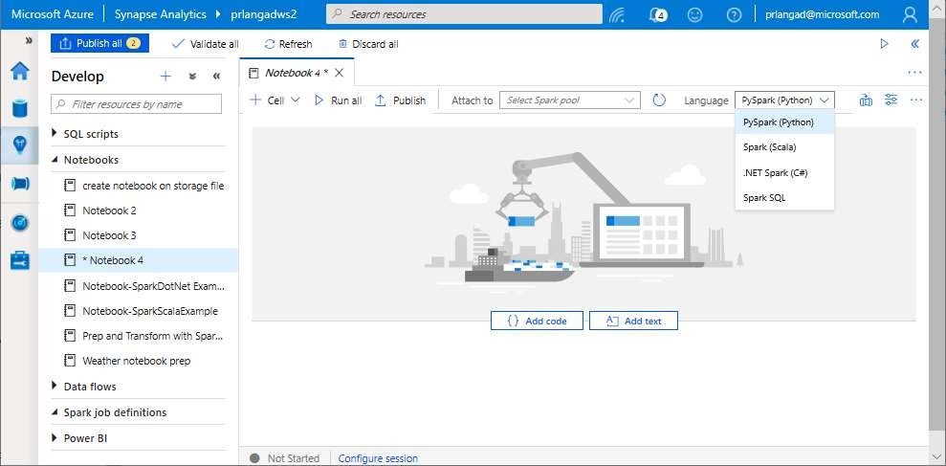
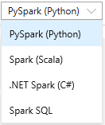
Synapse Spark Notebooks
Notebooks
Allows to write multiple languages in one notebook
%%<Name of language>
Offers use of temporary tables across
languages
Language support for Syntax highlight, syntax error, syntax code completion, smart indent, code folding
Export results

Slide 25
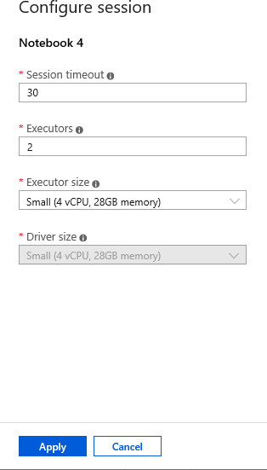
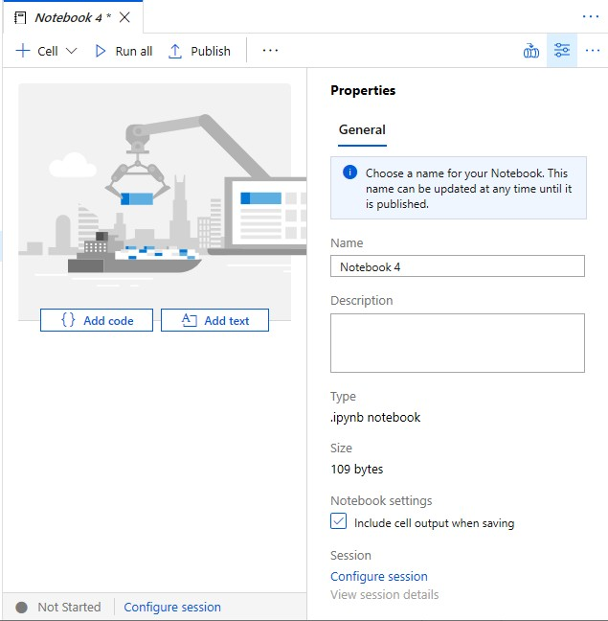
Synapse Spark Notebooks
Configure session allows developers to control how many resources
are devoted to running their notebook.

Slide 26
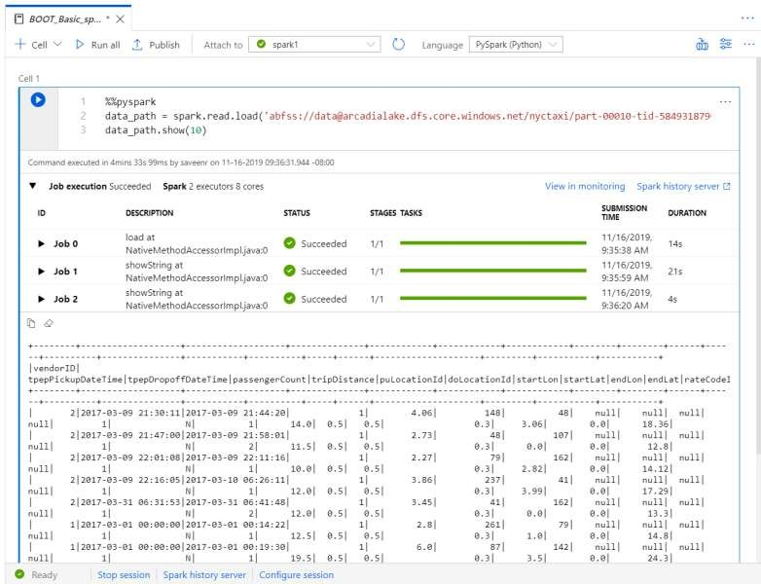
Synapse Spark Notebooks
As notebook cells run, the underlying Spark application status is shown.
Providing immediate feedback and progress tracking.

Slide 27
Exercise-3 [20 minutes]
Create Synapse Spark notebook to find top products
Task 1: Create notebook
Task 2: Add the Notebook to the pipeline

Slide 28
Break
(15 minutes)

